Slide 1

Welcome!
Sunday
  Bible Classes 10:00 AM
  Worship 10:50 AM
  2:00 PM
  Radio Program 8:05 AM
Wednesday
  Bible Classes 7:00 PM
Bibles and copies of sermons are available
Please silence your cell phones
www.TucumcariChristians.com

Slide 2

Hebrews 12:28
Therefore, since we are receiving a kingdom which cannot be shaken, let us have grace, by which we may serve God acceptably with reverence and godly fear.

Slide 3
Why Not Testify?

Slide 4
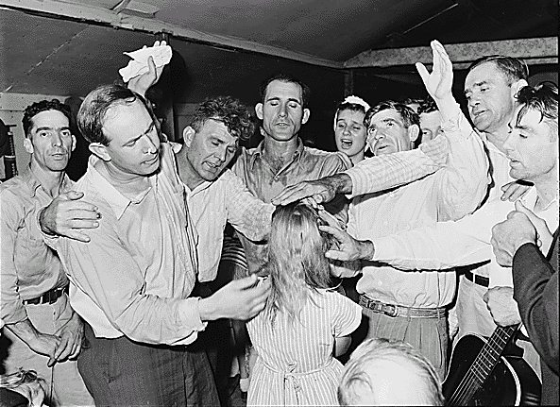
The Concept of Testimonies
To relate a personal experience that is believed to be an encounter with God
Giving a testimony about what Jesus has done for them

Slide 5
Some Questions About Testimonies
Does every person who becomes a Christian have a personal encounter with God, an experience which proves that he or she is saved?

Slide 6
Some Questions About Testimonies
Is that kind of experience necessary in order to teach the gospel to a lost & dying world?

Slide 7
Some Questions About Testimonies
Is that the proper way to tell others about the gospel?

Slide 8
Are All “Experiences” The Same?
"For the promise is to you and to your children, and to all who are afar off, as many as the Lord our God will call.“ Acts 2:39
"But we believe that through the grace of the Lord Jesus Christ we shall be saved in the same manner as they.“ Acts 15:11

Slide 9
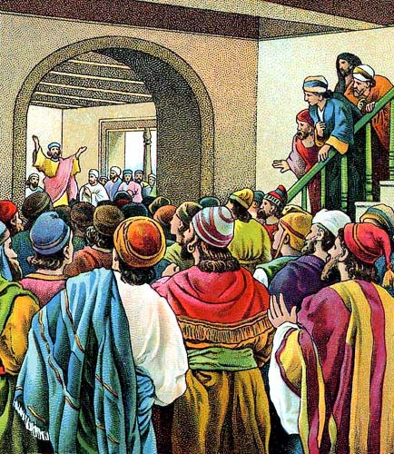
Are Experiences Necessary to be Saved?
Jews heard and believed in Acts 4
Gentiles heard and believed in Acts 13
Ephesians heard and believed in Ephesians 1:13

Slide 10
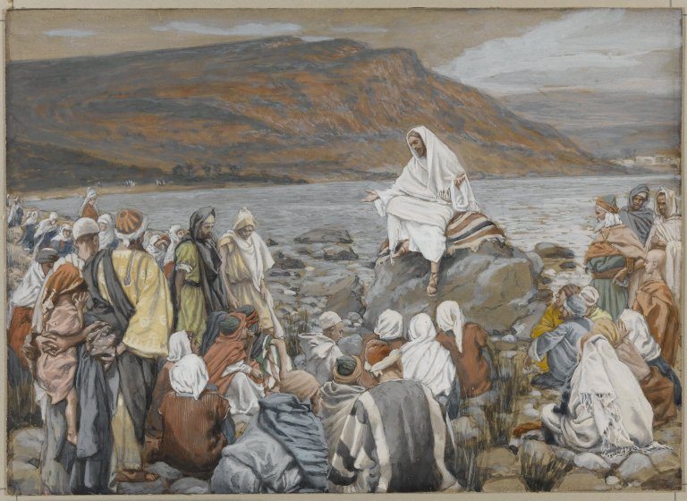
Is This How The Gospel Moved?
Moreover, brethren, I declare to you the gospel which I preached to you…. I Corinthians 15:1a
…..those who have preached the gospel to you by the Holy Spirit sent from heaven--things which angels desire to look into. I Peter 1:12b

Slide 11
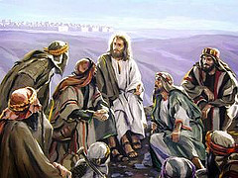
But What About the Apostles?
Called to testify of their experiences
"But you shall receive power when the Holy Spirit has come upon you; and you shall be witnesses to Me in Jerusalem, and in all Judea and Samaria, and to the end of the earth." Acts 1:8

Slide 12
But What About the Apostles?
Called to testify of their experiences
Only after the Holy Spirit came on them

Slide 13
“The Holy Spirit Came Upon Me”
Promises to the Apostles:
The keys of authority – Matthew 18
The authority of forgiveness – John 20
The Holy Spirit to reveal all things – John 16
These are unique to the Apostles

Slide 14
Identifying an Apostle
Truly the signs of an apostle were accomplished among you with all perseverance, in signs and wonders and mighty deeds. II Corinthians 12:12

Slide 15
Identifying an Apostle
Without the signs one is not an apostle
“….you have tested those who say they are apostles and are not, and have found them liars” Revelation 2:2

Slide 16
Testimony is Not Pleasing to God
It removes the power of the Gospel
It glorifies men over God
It was not meant to be used

Slide 17
Confession is Pleasing to God
Let us draw near with a true heart in full assurance of faith, having our hearts sprinkled from an evil conscience and our bodies washed with pure water. Let us hold fast the confession of our hope without wavering, for He who promised is faithful. Hebrews 10:22-23

